Slide 1
Chapter 12
Inheritance and Exceptions
Lecture Slides to Accompany
An Introduction to Computer Science Using Java (2nd Edition)
by
S.N. Kamin, D. Mickunas, E. Reingold

Slide 2
Chapter Preview
In this chapter we will:
show how to organize predefined classes using Java packages
how access to methods and variables is controlled
discuss the use of class inheritance to refine and extend classes
refine our presentation on Java interfaces as a means of specifying object behavior
show how programmer-defined exceptions are created, thrown and caught

Slide 3
Java Packages
Application programmer interface (API)
  All classes provided to programmers along with the Java compiler (e.g. Math or MouseEvent)
  Java expects to find these classes in separate directories or folders
The classes stored in each directory form a package
The package names are formed by concatenating the directory names starting from a particular root directory

Slide 4
Some Predefined Java Packages
Package Name | Contents
java.applet | Classes for implementing applets
java.awt | Classes for graphics, windows, and GUI’s
java.awt.event | Classes supporting AWT event handling
java.awt.image | Classes for image handling
java.awt.peer | Interface definitions s for platform independent graphical user interfaces (GUI’s)
java.io | Classes for input and output
java.lang | Basic language classes like Math (always available in any Java program)
java.net | Classes for networking
java.util | Useful auxiliary classes like Date

Slide 5
Package Component Names
Using a fully qualified component name
  x = java.lang.Math.sqrt(3);
Using an import statement
  // to allow unqualified references to
  // all package classes
  import package.name.*;
  // to allow unqualified references to
  // a particular package class
  import package.name.class_name;

Slide 6
Import Examples
This code
java.util.Date d =
new java.util.Date();
java.awt.Point p =
new java.awt.Point(1,2);
java.awt.Button b =
new java.awt.Button();
Can be abbreviated
import java.util.date;
import java.awt.*;
…
Date d = new Date();
Point p = new Point(1,2);
Button b = new Button();

Slide 7
Creating Your Own Packages
Each package class must be stored in a file in an appropriately named directory
The source code file for each package class must contain a package statement as its first non-commented statement
    package package_name;
Several packages can be stored in the same directory
Classes in different directories cannot be part of the same package

Slide 8
Visibility Rules and Packages
Instance variables declared as public or private have the same visibility to classes in other packages
Instance variables without explicitly declared visibility have package visibility
Instance variables with package visibility are only visible to methods defined in classes belonging to the same package
Similarly for static variables, instance methods, and static methods having package visibility
Classes not explicitly declared public are not visible outside the package

Slide 9
Inheritance
Allows programmers to customize a class for a specific purpose, without actually modifying the original class (the superclass)
The derived class (subclass) is allowed to add methods or redefine them
The subclass can add variables, but cannot redefine them

Slide 10
Inheritance Example
Class C is a subclass of class B (its superclass) if its declaration has the form
  class C extends B {
  …
  }
The subclass is a specialization of the superclass
The superclass is a generalization of the subclass

Slide 11
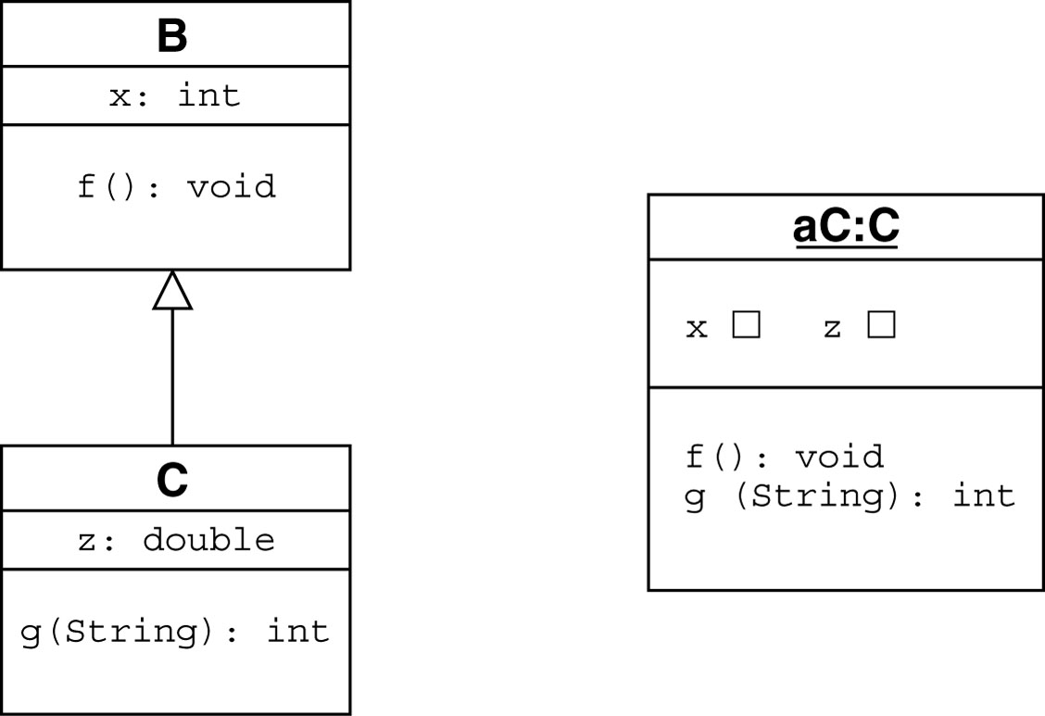

Slide 12
Inheritance and Messages
When C is a subclass of B
  C objects can respond to all messages that B objects can respond to
  In general C objects can be used whenever B objects can be used
It is possible the a subclass of B may have methods and variables that have not been defined in B
  It is the case B objects may not always be used in place of C objects

Slide 13
Inheritance Hierarchy
A class may have several subclasses and each subclass may have subclasses of its own
The collection of all subclasses descended from a common ancestor is called an inheritance hierarchy
The classes that appear below a given class in the inheritance hierarchy are its descendaents
The classes that appear above a given class in the inheritance hierarchy are its ancestors

Slide 14
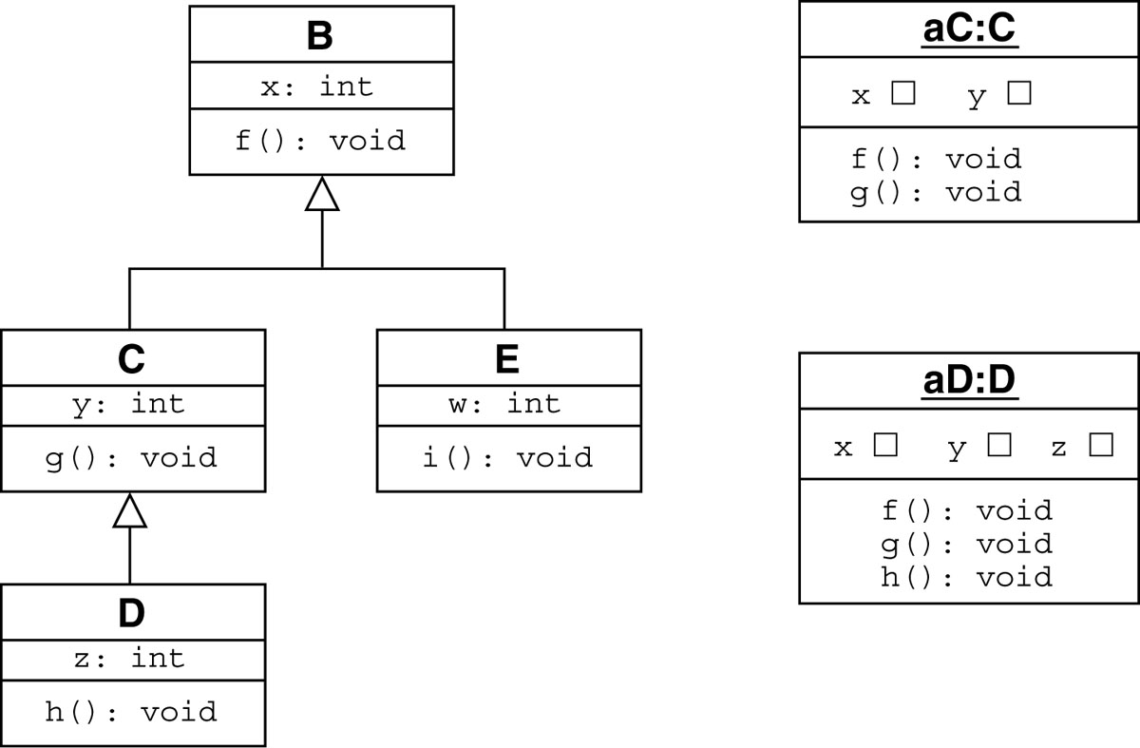

Slide 15
Inheritance and Visibility Rules
Private variables and methods are not visible to subclasses or clients
Public variables and methods are visible to all subclasses and clients
Variables and methods with package visibility are only visible to clients defined in the same package as the class and subclasses.
A variable or method declared with the protected visibility modifier can only be referenced by subclasses of the class and no other classes

Slide 16
Visibility and Inheritance
Visibility | Public | default | protected | private
Clients in same package | C | C | C | None
Clients in different packages | C | None | None | None
Subclass in same package | C & R | C & R | C & R | None
Subclass in different package | C & R | None | R | None
 | Note: R is receiver; C is client

Slide 17
Overriding vs Overloading
A method is overloaded if it has multiple definitions that are distinguished from one another by having different numbers or types of arguments
A method is overridden when a subclass gives a different definition of the method with the same number and types of arguments

Slide 18
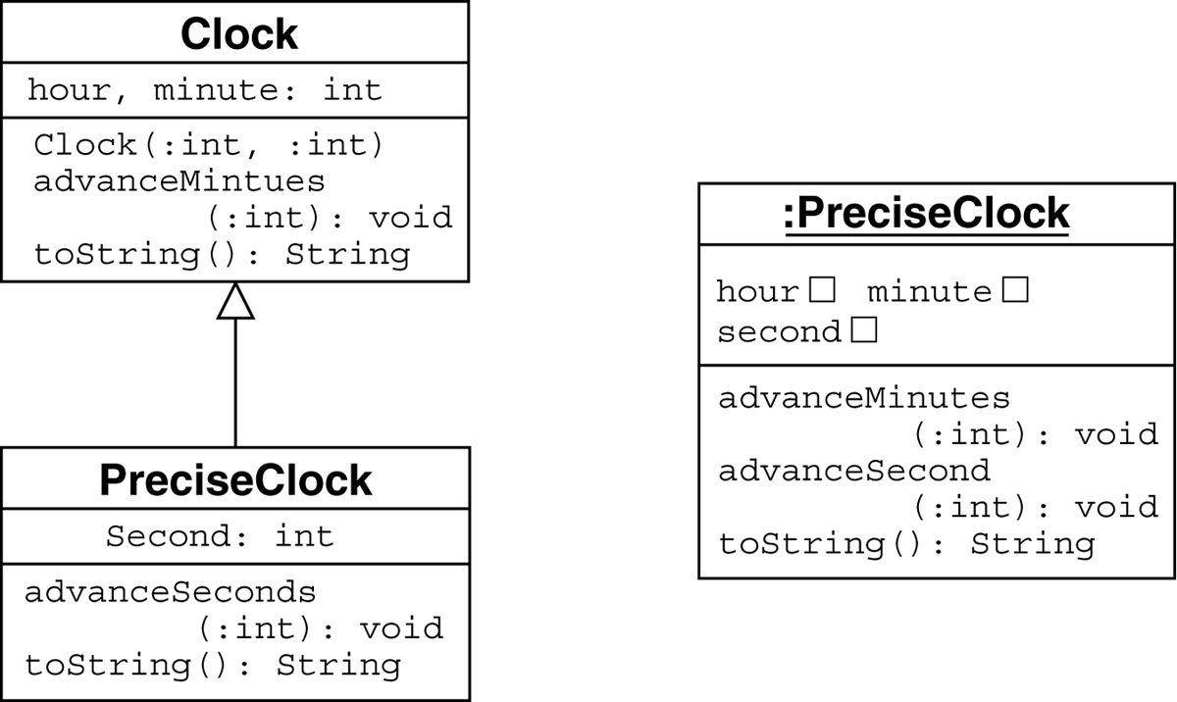

Slide 19
Constructors
The general rule is that when a subclass is created Java will call the superclass constructor first and then call the subclass constructors in the order determined by the inheritance hierarchy
If a superclass does not have a default constructor with no arguments, the subclass must explicitly call the superclass constructor with the appropriate arguments

Slide 20
Using super( ) Call Constructor
The call to super must be the first statement in the subclass constructor
Example:
  class C extends B {
  …
  public C ( … ) {
  super( B’s constructor arguments );
  …
  }
  …

Slide 21
Calling Overridden Superclass Methods from Subclassess
The following code generates an infinite loop because toString( ) is interpreted as this.toString( )
  public void toString() {
  String result = toString();
  return (result + “:” + second);
  }
To make a call toString in the superclass instead
  public void toString() {
  String result = super.toString();
  return (result + “:” + second);
  }

Slide 22
Creation of Subclass Instances
Assuming that PreciseClock is a subclass of the Clock class, the following is legal
  Clock dawn;
  dawn = new PreciseClock(3,45,30);
The instance variable dawn will respond to all PreciseClock messages
It is not legal to write this since Clock objects cannot respond to all PreciseClock messages
  PreciseClock dawn;
  dawn = new Clock(3,40);

Slide 23
Static and Dynamic Binding
Static Binding
  Determining which method will be invoked to respond to a message at compile time
Dynamic Binding
  Determining which method will be invoked to respond to a message at run time
  Required when method definitions are overridden in subclasses, since type of the receiver class may not be known until run time

Slide 24
Abstract Classes
Abstract classes are only used as super classes
Classes are declared as abstract classes only if they will never be instantiated
Abstract classes contain usually one or more abstract methods
Example:
  public abstract class Mouse implements Direction {
  …
  abstract void makeMove( );
  }

Slide 25
Abstract Methods
Abstract methods have no body at all and just have their headers declared
The only way to use an abstract class is to create a subclass that implements each abstract method
Concrete classes are classes that implement each abstract method in their superclasses
Example:
  abstract void makeMove( );

Slide 26
Exceptions
Exceptions are things that are not supposed to occur
Some exceptions (like division by zero) are avoidable through careful programming
Some exceptions (like losing a network connection) are not avoidable or predictable
Java allows programmers to define their own means of handling exceptions when they occur

Slide 27
Exception-Handling Mechanism
Mechanism for creating special exception classes (whose instances are called exception objects)
The statement throw e is used to signal the occurrence of an exception and return control to the calling method and e refers to an exception object
The statement try/catch allows the calling method to “catch” the “thrown” exception object and take appropriate actions

Slide 28
Exception Example
The body of a method may call other methods as well as doing its own calculations
Here the body of m will execute unless an out-of bounds exception occurs
  void m (){
  try {
  … body of m …
  }
  catch (ArrayIndexOutOfBoundsException ae) {
  … code to recover from error …
  }
  }

Slide 29
Control Flow and Exceptions
When exception is thrown control returns through the methods called in reverse calling order until a try statement is found with a catch block for the exception
It is possible for a catch statement to defer handling of an exception by including a throw statement of its own

Slide 30
Exception in p Handled by n
void m() {
…
try { … n() … }
catch (ArrayIndexOutOfBounds ae) { … }
…
}
void n() {
…
try { … p() … }
catch (ArrayIndexOutOfBounds ae) { … }
…
}
void p() { … A[I] … }

Slide 31
Deferring Exception Handling to n’s Calling Method
void n() {
…
try { … p() … }
catch (ArrayIndexOutOfBounds ae) {
if ( able to handle error )
handle it
}
else throw ae;
}
…
}

Slide 32
finally Clause
When exception is thrown control is transferred to method containing the catch block to handle the exception
Control does not return to procedure in which the exception was thrown unless it contains a finally clause
The finally clause can be used to clean up the programming environment after the exceptions has been handled

Slide 33
Finally clause Example
void n() {
…
try { … open window … p() … }
catch (SomeException se) { … }
finally { … close window … }
…
}
void p() { … throw se … }

Slide 34
Handling Multiple Exceptions
void m() {
…
try { … n() … }
catch (ArrayIndexOutOfBounds ae) { … }
catch (NullPointerException npe) { … }
…
}
void n() {
try {… A[I] … anObject.v … }
finally { … }
…
}

Slide 35
Exception Hierarchy
Try can catch any exception using the following code
  try { … }
  catch (Exception e) {
  … handle any type of exception …
  }
You must be careful because Java executes the first catch statement it finds that capable of handling the exception

Slide 36
Which handler is executed?
In this example the second handler is never executed
    try { … }
    catch (Exception e) { … }
    catch (ArrayIndexOutOfBounds ae) { … }
In this example the second handler is only executed if there is no array subscript error
    try { … }
    catch (ArrayIndexOutOfBounds ae) { … }
    catch (Exception e) { … }

Slide 37
Checked and Unchecked Exceptions
Unchecked exceptions do not have to be handled (e.g. ArrayIndexOutOfBounds or NullPointer)
Checked exceptions must be handled when they occur
Most programmer defined exceptions are for checked exceptions

Slide 38
Programmer Defined Exceptions
class InvalidIntegerException extends Exception {
InvalidIntegerException (String s) {
super(s);
}
InvalidIntegerException () {
this(“”);
}
}

Slide 39
Method Header Throws Clauses
void m() {
…
try { … N() … }
catch (InvalidIntegerException iie) { … }
…
}
void n() throws InvalidIntegerException {
… p() …
}
void p() throws InvalidIntegerException {
… throw new InvalidIntegerException(); …
}

